Slide 1
What role for language?
Dr Tim Kurz
Psychology, University of Bath
t.kurz@bath.ac.uk

Slide 2
What do I do?
A social psychologist by training
Have always been methodologically and epistemologically ‘multi-lingual’
  Realist experimentalism through to social constructionist discourse/conversation analysis
Binding interest?
  a fascination with the role of language/discourse in the social world

Slide 3
Thinking about Language Discursively
As a rhetorical tool we use to construct a version of ‘reality’ that suits our situated purpose
  E.g., Constructions of recreational pole dancing (‘fun’, ‘just like any other dancing’)
As a resource that furnishes our debates with culturally taken-for-granted understandings
  E.g., Political rhetoric around climate change (‘national interest’, ‘lifestyle maintenance’)
As a medium through which we achieve the various and varied business of social interaction
  E.g., The production of a ‘moral mother’ identity amongst those who formula feed their infants in the face of ‘Breast is Best’ campaigns that tell them to ‘not feel guilty’

Slide 4
Thinking about Language Cognitively/Experimentally
As something we can ‘count’ (as a DV)
  E.g., Coding reproduction of stereotype consistent/inconsistent content in stories about members of own/other groups to different audiences
  Coding for different ways of framing climate change in media coverage of IPCC reports
As something that can quantitatively influence (as an IV) people’s thinking and behaviour
  E.g., Effects of constructing fines as retribution vs compensation on levels of co-operative compliance

Slide 5
How to Understand Humility/Arrogance in Debate?
As I understand the project…
  Phase I: Work out what humility/arrogance ‘looks like’ (how do we spot it when it is there?)
  Phase 2: Use this ‘spotting tool’ to measure the quantity of its occurrence under different conditions (e.g. self affirmation etc)

Slide 6
Some Spotting Challenges
Are arrogance/humility:
A) Ways of being that we have?
    (like an attitude or a personality trait or psychological state)
    Someone is (being) arrogant/humble
    …we might look for interactional markers of this ‘bubbling over’?
B) Actions that we perform in social interaction?
    (like an accusation, a blaming, an agreement or an assessment)
    Someone has done arrogance/humility
    ….we might analyse how this was achieved and to what end?
    Note: People probably ‘do humility’ all the time (and not necessarily a ‘good’ thing)
C) Concepts that we invoke directly in social interaction to achieve interactional business
    (like an identity category [‘speaking as a mother’] or an emotional state [‘what you said hurt my feelings’])
    Someone has put arrogance/humility to work in interaction
    …we might analyse what work the concepts perform?

Slide 7
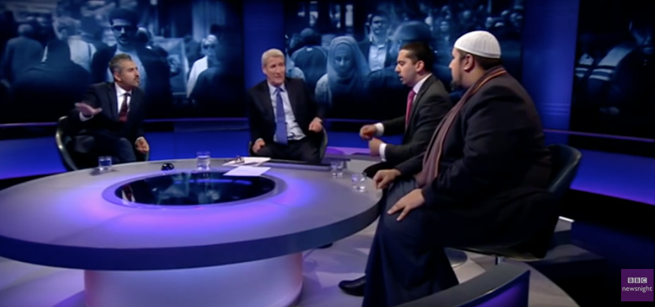
Playing with an example
https://www.youtube.com/watch?v=noOPNkxQE9M (4:50-5:12)

Slide 8
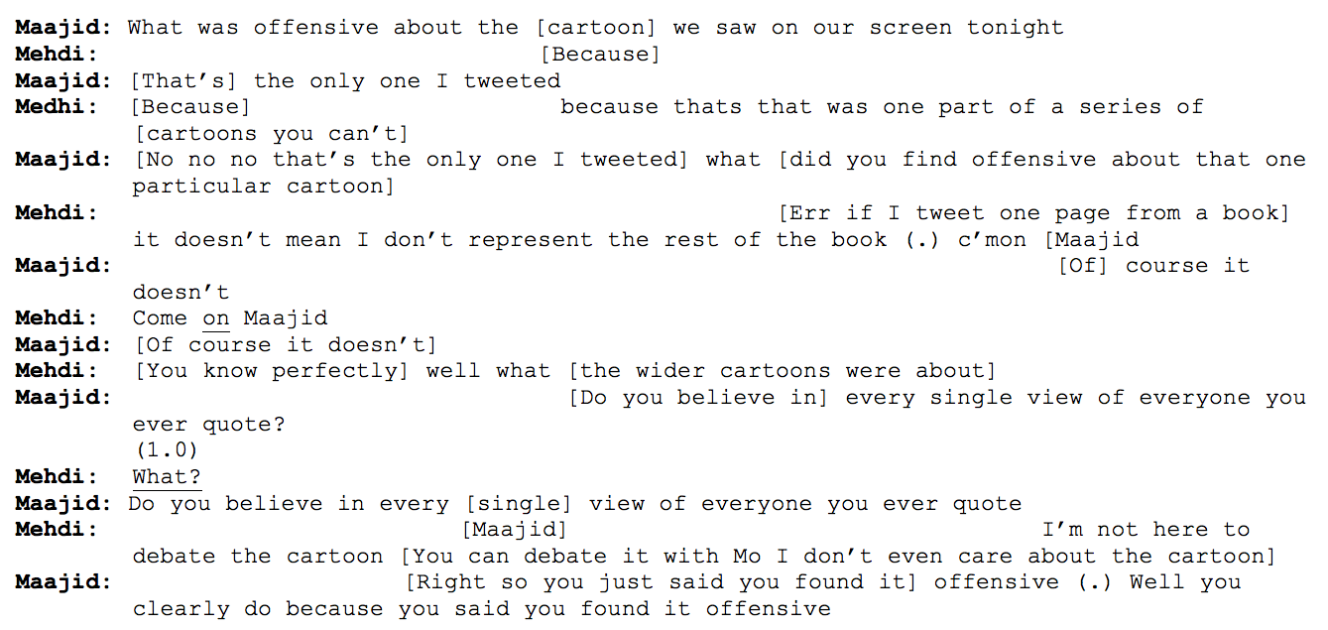
A few things…

Slide 9
Overlapping talk

Slide 10
Using pauses to ’do confusion’

Slide 11
Addressing interlocutor by name

Slide 12
Making claims to others’ psychological states

Slide 13
Constructing one’s own position as self-evident

